Slide 1
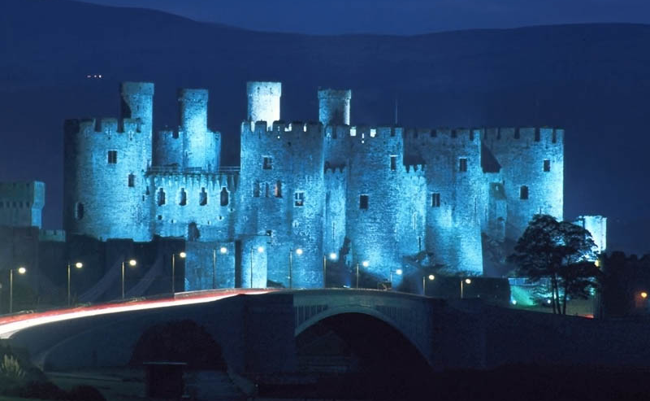
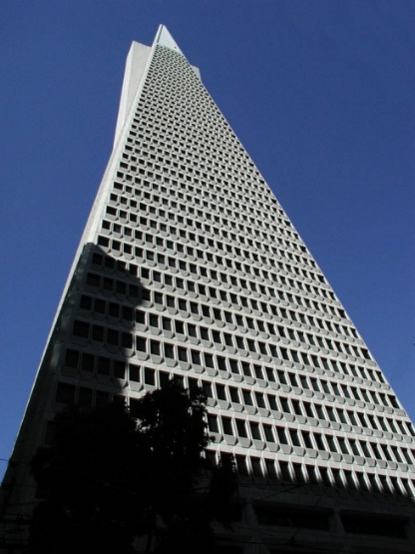
Software Architecture DIT344 Michel R.V. Chaudron chaudron@chalmers.se Software Engineering Division Chalmers | GU

Slide 2

Software Architecting DIT541 Michel R.V. Chaudron chaudron@chalmers.se Software Engineering Division Chalmers | GU

Slide 3
Presentation Change History
Date Aut Description
3 jan 2002 MC Added: Evaluation Book; SA def. by Sikkema
Jan 2013 MC adapted slides for Adv SW Arch course at Chalmers | GU
Aug 2017 MC adapt for BSC SW ARCH Chalmers|GU
To do: Security, e.g. Christopher M. King, Ertem Osmanoglu (Editor),
Curtis Dalton, "Security Architecture: Design, Deployment and
Operations. McGraw-Hill Osborne Media; 1st Edition (July 30, 2001).

Slide 4
About Michel Chaudron
Research:
Professor of the Software Engineering Group, Gothenburg
Previously in Leiden and Eindhoven, Netherlands
Research Interests:
Software Architecture-, Design & Modeling, UML, Empirical studies in SE
How can we predict properties of the systems we design ?
Can we quantify the effects of ‘doing architecture’
In industrial SE projects or via experiments
Coordinates:
chaudron@chalmers.se
Room 472, floor 4, Jupiter building, Campus Lindholmen
Phone +46 31 772 11 65

Slide 5
Goals of this course
Knowledge:
concepts & terminology
engineering standards & pragmatics
modelling notations & analysis techniques
‘standard’ solutions
‘soft skills’ are important
introduction of some research topics
Skills:
design & documentation of architectures
assessment of architectures

Slide 6
Introducing … YOU
Who are you?
What is your background?
What is you B.Sc.?
Swede or Elsewhere?
How many have industrial experience?
What do you expect / want to learn?

Slide 7
My rules
Questions are very welcome
No laptops during lectures in class

Slide 8
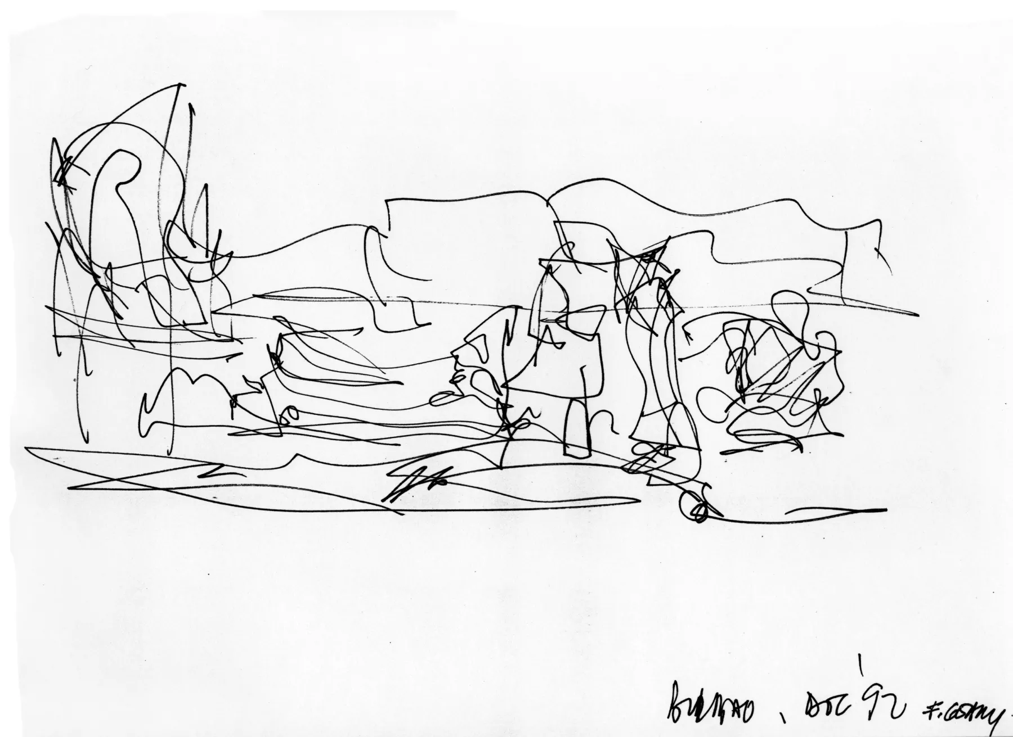
What is this? What is it for?

Slide 9
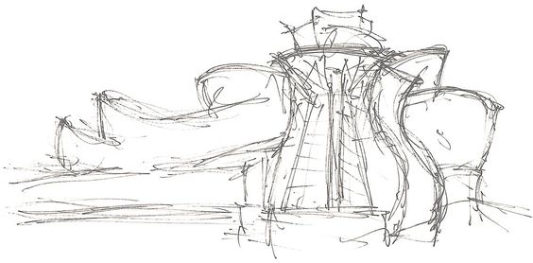

Slide 10
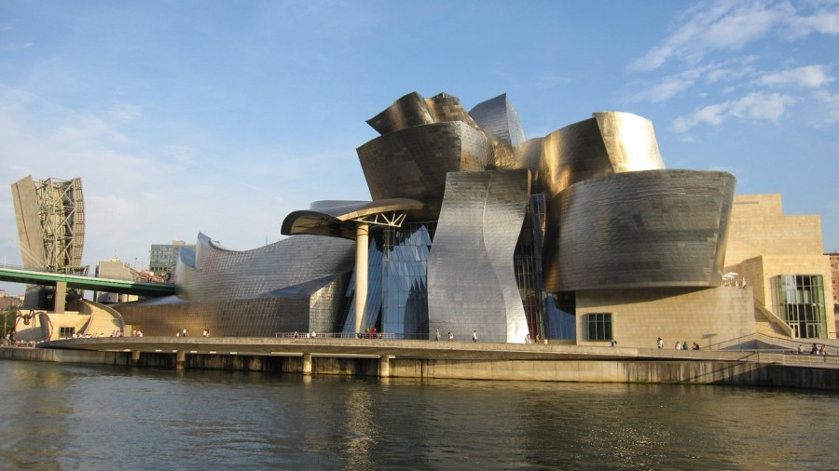
Form & Function

Slide 11
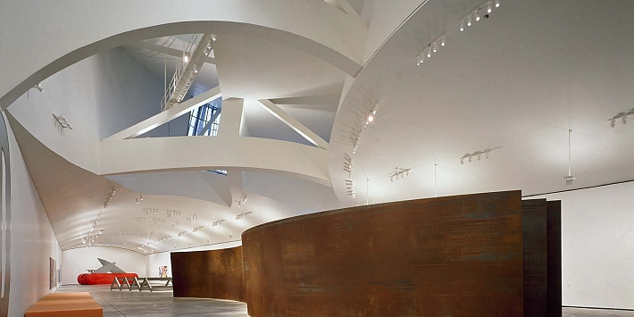
Space, Light

Slide 12
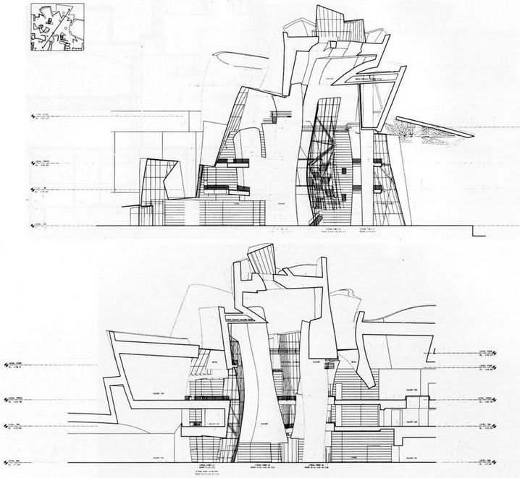

Slide 13
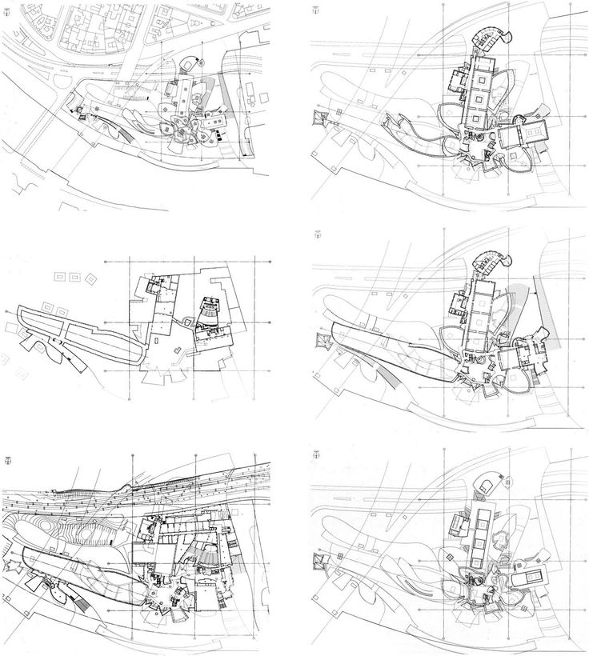
Building in its environment

Slide 14
To Do

Slide 15
Schedule
Week |  | Date | Time | Lecture | Reading | Note
36 | L1 | 5 sept | 13:00 – 15:00 | Introduction & Organization
37 | L2 | 12 sept | 13:00 – 14:30 | Architecting Process & Views | Ch 1 & 2
37 | S1 | 13 sept | 10:15-1200 | << Supervision/Assignment>>
38 | L3 | 18 sept | 15:00 (confirmed) | Requirements & Quality Attributes | Ch 3 & 4
38 | S2 | 20 sept | 13:00 – 15:00 (confirmed) | << Supervision/Assignment>>
38 | L4 | 21 sept | 13:15 – 15:00 | Architectural Styles 1 | Ch 13
39 | L5 | 26 sept | 13:15 – 15:00 | Architectural Styles 2 | Ch 15 & 16 | DoDocSys
39 | S3 | 27 sept | 10:15 – 12:00 | << Supervision/Assignment>>
39 | L6 | 28 sept | 13:15 – 15:00 | Roles and Responsibilities | Check GUL | UG
40 | L7 | 3 Oct | 13:15 – 15:00 | Technical Debt | Check GUL | UG
40 | S4 | 4 Oct | 10:15 – 12:00 | << Supervision/Assignment>>
40 | L8 | 5 Oct | 13:15 – 15:00 | Design Principles | tbd
41 | L9 | 10 Oct | 13:15 – 15:00 | Architecture Evaluation | Ch 21
41 | S5 | 11 Oct | 10:15 – 12:00 | << Supervision/Assignment>>
42 | L10 | 17 Oct | 13:15 – 15:00 | Guest lecture | tbd | MODELS
42 | L11 | 19 Oct | 13:15 – 15:00 | To be determined |  | MODELS
43 | L12 | 24 Oct | 13:15 – 15:00 | Reverse Engineering & Correspondence | Ch 20
43 | S6 | 25 Oct | 10:15 – 12:00 | << Supervision/Assignment>>
43 | L13 | 26 Oct | 13:15 – 15:00 | To be determined
Mandatory!

Slide 16
Teaching Philosophy
Tools
Directions
If you have a hammer, then this doesn’t mean all problems are a nail!

Slide 17
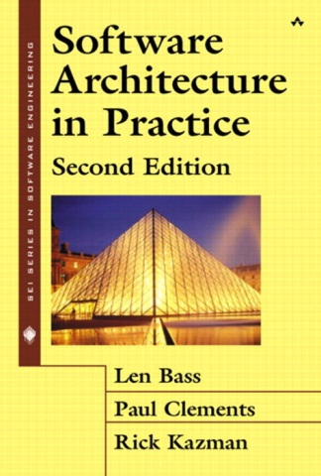
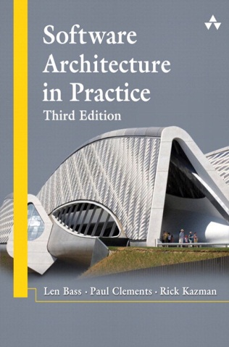
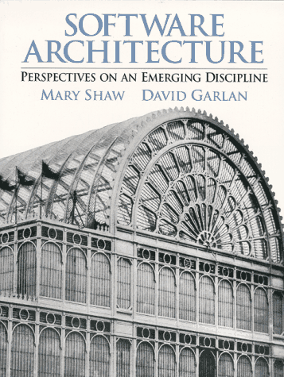
Software Architecture Books
Software Architecture in Practice, 3rd Edition,
L. Bass, P. Clements, R. Kazman,
SEI Series in Software Engineering,
Addison-Wesley, 2003
Software Architecture: Perspectives on an
Emerging Discipline, Mary Shaw, David Garlan,
242 pages, 1996, Prentice Hall
Recommended Practice for Architectural Description,
IEEE STD 1471-2000, 23 pages

Slide 18
UML book
UML Distilled
4th or 3rd edition

Slide 19
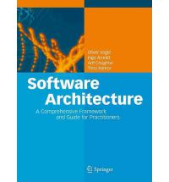
Software Architecture Books
Software Architecture A Comprehensive Framework and Guide for Practitioners
By Oliver Vogel, Ingo Arnold,
Arif Chughtai, Timo Kehrer

Slide 20
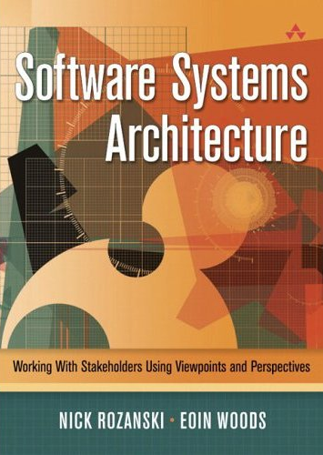
Software Architecture Books
Software Systems Architecture – With Stakeholders Using Views and Perspectives
by Nick Rozanski and Eoin Woods,
Addison-Wesley, 2005

Slide 21
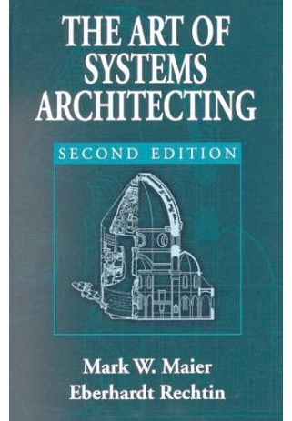
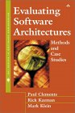
Software Architecture Books
The Art of Systems Architecting, Second Edition (Hardcover) by Mark W. Maier, Eberhardt Rechtin
Publisher: CRC Press, 2000
Evaluating Software Architecture
(SEI Series in Software Engineering)
Paul Clements, Rick Kazman, Marc Klein,
386 pages, 2002, Addison-Wesley,
ISBN 020170482X

Slide 22
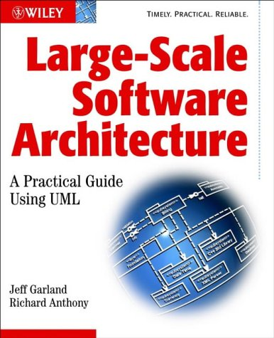
Software Architecture Books
Large Scale Software Architecture
A Practical Guide Using UML
by Jeff Garland & Richard Anthony,
Wiley, 2002.

Slide 23
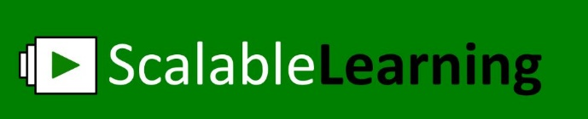
Video Lectures
Scalable Learning
Online platform
You can create an account and register for our course
You can watch lectures online – when & where you want
You ask questions online
https://www.scalable-learning.com/#/courses/1111/modules/3525/courseware/lectures/14201
Let me know how you prefer to use the video’s:
Watch before hand
then I can find from ScalableLearning what you find difficult and pay more attention to this in class
Watch after my lecture
NOT A REPLACEMENT FOR ATTENDING CLASS LECTURES(YET!)

Slide 24
Assignment
To be announced
Start of term
UML
Examination:
Assignment
Written exam

Slide 25
Teaching Assistants
Terese Besker
Rodi Jolak
Truong Ho Quang

Slide 26
Outline
Organization of the lectures
Why, When, for Whom architecture?
What is Software Architecture?
How Software Architecting?
Concluding Remarks & References

Slide 27
Structure of the Course (1)
Introduction:
why, what, when, whom, …
course ‘logistics’
bit on requirements
Requirements, Architecture Modelling & Documentation
bit more about requirements
using UML for modelling
documentation guidelines

Slide 28
Structure of the Course (2)
Architecture Modelling
view paradigms (IEEE1471, 4+1, SHN, Zachmann)
ADL’s (AADL, UniCon, Splice, Darwin/Koala)
Architectural Styles
pipe-and-filter, blackboard, pub/sub, (P2P)
strenghts and weaknessess of styles
Client/Server & Middleware
2-tier, thick- thin C/S
Reverse EngineeringCORBA

Slide 29
Structure of the Course (3)
Architecture Evaluation
Qualitative:
Scenario-based: ATAM
Quantitative Techniques for Analysing Architectures
Reliability Block Diagrams, Rate Monotonic Analysis
Queuing Networks
Risk, Cost, Feasability
Roles & Responsibilities
Technical Debt
Guest lecture(s): to be confirmed

Slide 30
Tests
assignment parallel to course
final written test
I will try to test that
You know a few things (concepts, facts, UML, …)
You can do a few things
THINK – analyze, structure, reason logically
There are a few things from this course that are very important
I will emphasize them and expect you notice

Slide 31
Relation to Other CS subjects
Software Engineering
Distributed Systems
Databases &
Information Systems
Performance Modelling
Complexity Theory
Software Architecting
Central question:
How to design, document and assess software architectures.

Slide 32
Preview / Recap: What is Software Architecture?
A definition:
Software Architecture is the global organization of a software system, including
the division of software into subsystems/components,
policies according to which these subsystems interact,
the definition of their interfaces.
(free after) Object Oriented Software Engineering
T. C. Lethbridge & R. Laganière
McGraw Hill, 2001

Slide 33
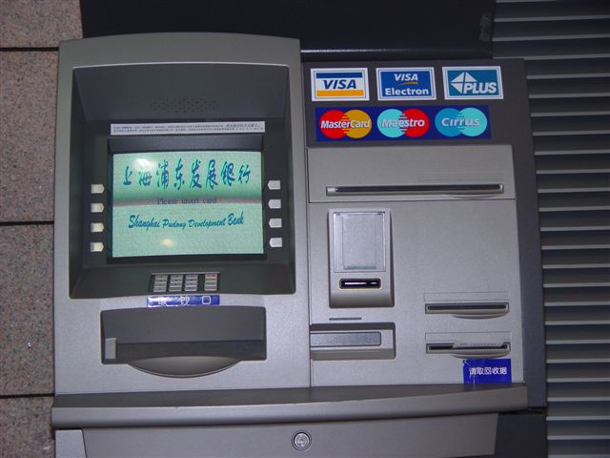
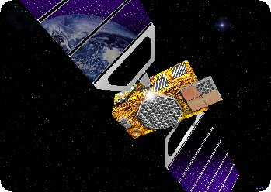
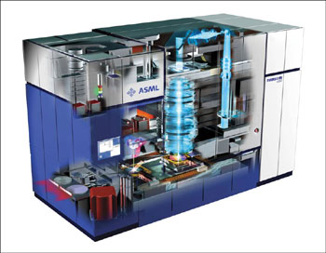
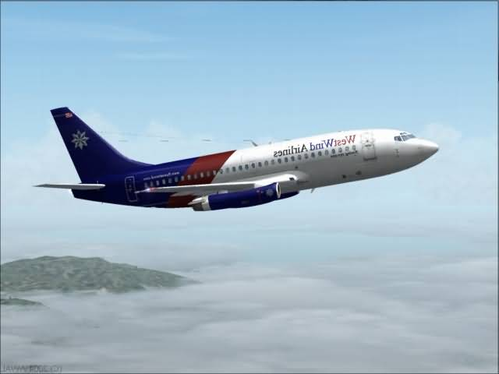
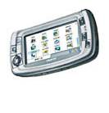
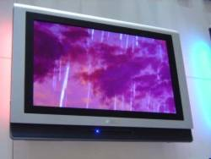
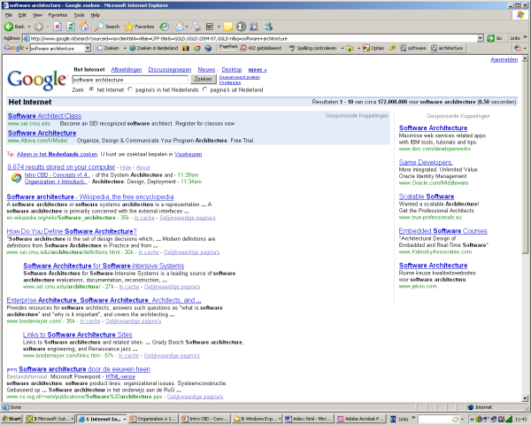


Slide 34
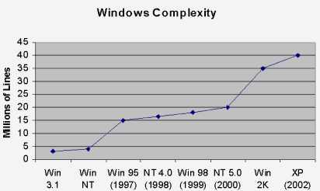
Increasing amount of software in systems
Nb: logarithmic scale
The amount of software
increases 10 fold every 10 years

Slide 35
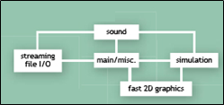
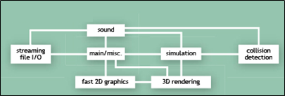
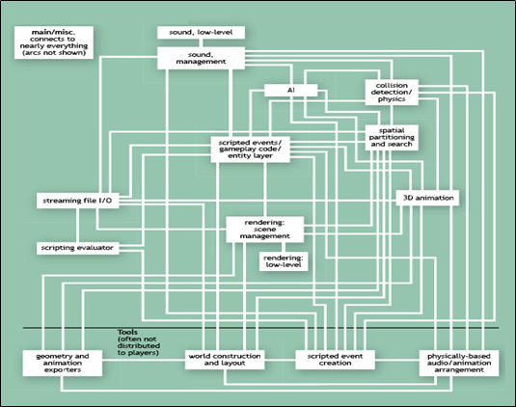
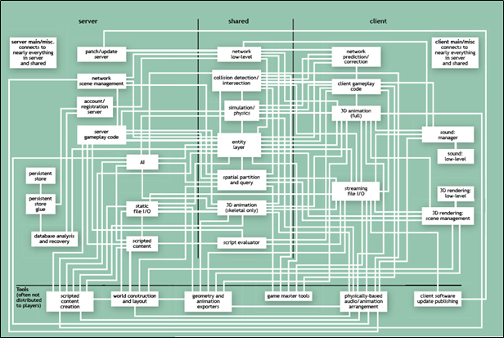
Increasing Complexity of Software
Blow, J. "Game Development: Harder Than You Think." ACM Queue

Slide 36
The Importance of Architecture
“A correct architecture has the largest single impact
on cost and quality of the product.”
Maranzano, ATT, 1995

Slide 37
The Importance of Architecture
10% of the lifecycle determines
90% of the costs and risks
≥ 100x
Requirements & Architecting
Design
Implementation
Testing
Deployment
Operation
SW fault repair costs
1x
Notes:
The costs of repairing a fault increases exponentially with the delay of its detection

Slide 38
Business Objectives of Sw. Arch.
Reduce time-to-market
Through enabling reuse and gradual evolution
Reduce development cost
Through improved communication between developers
and earlier assessment of design alternatives and
assessment of system risks
Reduce maintenance cost
Through incorporation of foreseeable changes
Improve product quality
Increase fitness for use through stakeholder involvement;
reduce errors through enforcement of conceptual integrity

Slide 39
Multiple Purposes of Architecture
Understanding + Analyzing
+ Communicating + Constructing
Understanding
Describing
Guiding
Why
What
How
Why is the system needed? What constraints apply?
Understanding the requirements
What are the important design decisions
What functions does the system provide?
What properties does the design have?
How can the system be built?
Figure from Gerrit Muller, How to Create a Manageable Platform Architecture

Slide 40
Let’s Look at some Examples

Slide 41
Technical Architecture (top-view)
NW-SV
Per.
WS
NW-SV
Per.
WS
MF
Per.
WS
ICM LAN
Utrecht
PMT LAN
Boxmeer
Fokker LAN
Hoogeveen
LAN
...
EXP-SV
Rt
Rt
Rt
EXP-SV
EXP-SV
Internet
Stork WAN
(StorkNet)
Understanding
Describing
Guiding
Why
FW
Legacy
What
How
laptops
EXP-SV
Rt
EXP-SV
Stork PS LAN
Amersfoort
Modems
ACC-SV
DEV-SV
NW-SV
Per.
WS

Slide 42
eCommerce Architecture Blueprint
VK
Par.
Trw
RD
AD
NRC
DtRG
Ad.g.
Ad.k.
Graf.
Meul.
DocA
DocR
MRe
Losv
Distr
Ab.A
Ab.R
Extranet
Internet
Intranet
Journ.
Auteurs
Nieuws-
dnsten
Advert.
(PR-bur)
Losse
verk.pt.
Vervoer-
ders
Distrib.,
bezorg.
Busin.
partners
Bedrijv.
Instell.
Advert.
(part.)
Abon-
nees
Bezoe-
kers
PCM
medewr.
Integration Platform (Message Broker)
Multi-channel Platform
Tel/CC
Brief/fax
Email
Website
Mobiel
ITV
...
Commerce Platform
Merkgebonden producten en diensten
Content
mgmt.
Content
publish.
Relatie
Onderh.
Advert.
aanbod
Advert.
Activ.
Merk
regels
Understanding
Describing
Guiding
Why
Gemeenschappelijke services
Search
&config.
Relatie
Profiles
Product
prijzen
What
How
PCM
regels
Work
flow
Security
ePaym’t
Content
DB
Relation
profile
DB
Bedrijfs
Regels
DB
Beveili-
gings
DB
Legacy Platform
ATEX
MedS
CCI
SII
Quark
VIP
Nova
Oman
Meul.
Lovr
Opls
ADS
TDS
NPD
Ami1
Ami2

Slide 43
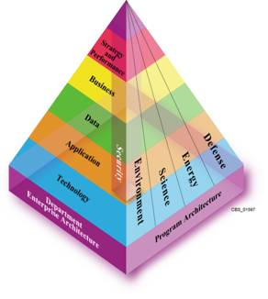
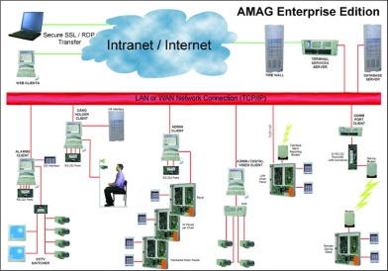
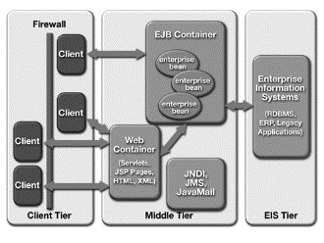
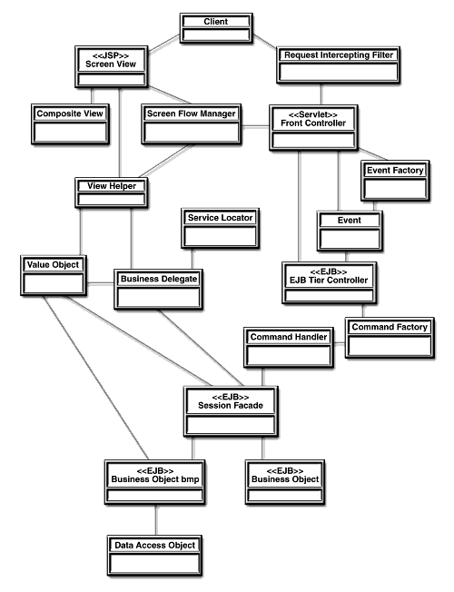
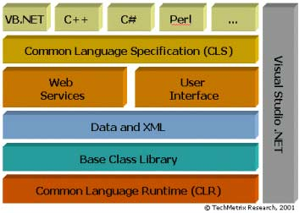
Levels of architecture*
Enterprise architecture
System architecture
Subsystem
Application architecture
Application
Macro-architecture
Frameworks
Micro-architecture
Subject
Observer
attach(Observer)
detach(Observer)
notify()
forall o in observers
o.update()
update()
Design patterns
ConcreteSubject
ConcreteObserver
* Mowbray and Malveau
getState()
update()
Notes:
Thomas J. Mowbray and Raphael C. Malveau. CORBA Design Patterns. John Wiley & Sons, 1997

Slide 44
From: CMU/SEI-2005-TN-027
From: Using the SEI Architecture Tradeoff Analysis Method to Evaluate WIN-T: A Case Study Technical Note CMU/SEI-2005-TN-027
Notes:
Using the SEI Architecture Tradeoff Analysis Method to Evaluate WIN-T: A Case Study
Paul Clements, Software Engineering Institute
John Bergey, Software Engineering Institute
Dave Mason, U.S. Army’s Communications and Electronics Command (CECOM)
September 2005
Technical Note CMU/SEI-2005-TN-027

Slide 45
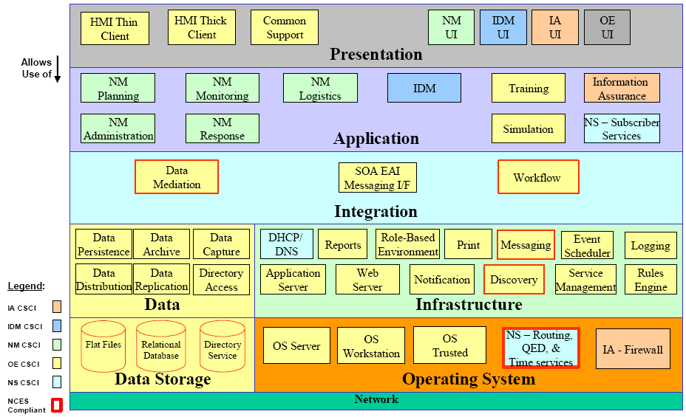
Refinement of previous slide
From: Using the SEI Architecture Tradeoff Analysis Method to Evaluate WIN-T: A Case Study Technical Note CMU/SEI-2005-TN-027

Slide 46
Complementary view of previous
From: Using the SEI Architecture Tradeoff Analysis Method to Evaluate WIN-T: A Case Study Technical Note CMU/SEI-2005-TN-027

Slide 47
Software Architecture of K9 e-mail app (on Android )

Slide 48
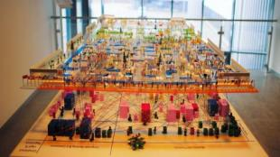
Banking Physical Architecture

Slide 49
What is Software Architecture?
Classic Definitions 1
An architecture is the set of significant decisions about
the organization of a software system,
the selection of the structural elements and their interfaces by which
the system is composed, together with their behaviour as specified in
the collaborations among those elements,
the composition of these structural and behavioural elements into
progressively larger subsystems,
the architectural style that guides this organization
The UML Modeling Language User Guide, Addison-Wesley, 1999
Booch, Rumbaugh, and Jacobson

Slide 50
What is Software Architecture?
Definition 2
The fundamental organization of a system embodied by its components, their relationships to each other and to the environment and the principles guiding its design and evolution
IEEE Standard P1471 Recommended Practice for
Architectural Description of Software-Intensive Systems

Slide 51
What is Software Architecture?
Definition 3
IT-Architecture is the collection of principles, guidelines and modelling standards that are used to guide the development, maintenance and use of IT-resources within the entire organization.
M. Sikkema (banking industry)
Translation by M.R.V. Chaudron
Ontwikkelen Onder Architectuur, Informatie, juni 2000
Oriented towards enterprise systems.

Slide 52

Software Project Management
The Deadline
by Tom DeMarco
easy & fun reading
lots of lessons from practical experience
Also very though provoking:
Peopleware
by DeMarco & Lister,
Dorset House Publ., 2nd ed, 1999

Slide 53
Material
Check GUL (under construction)
- Lecture Presentations
- Articles
- Background info & links
More as we go along ...
work in progress ...

Slide 54
Outline
Organization of the course
Why, When, for Whom architecture?
What is Software Architecture?
How Software Architecting?
Concluding Remarks & References

Slide 55
Concluding Remarks 1
Experience is the hardest kind of teacher.
It gives the test first and the lesson afterward.
Susan Ruth, 1993
Software Architecture is a critical aspect in the design and development of software
We discussed definitions and objectives of Sw.Arch.
Good architectural design requires human creativity, hard work, and a critical attitude.
Understanding of basic principles of architecture design, analysis, documentation, and process are necessary, but experience is hard to beat.
Notes:
Additional problems:
Common definitions and terminology
What architectural descriptions need the various stakeholders?
What are suitable orthogonal design dimension?
Derivation of these descriptions from a common framework?
Criteria for the assessment of the quality and performance of IT-Architectures?
To what extent are object-orientation and formal methods useful?
When does a project requires a major architecting effort
and what is a suitable architecting process?
How to deal with the product-process interdependence?
How to manage the architecting function in an organization?

Slide 56
